Slide 1



SWAN
GPIO Issue PCBA list
SH Son
Model Name: BFX-UA300
Document Version: ALT_STB_MP_CSMTINS_001
Issued Date: 2022.04.28

Slide 2
PCBA LIST
 | Korea |  | Vietnam
PCBA SN | VS-550 CHIPID | Checked date | PCBA SN (option) | VS-550 CHIPID
YW70UN1 | bd05ca10000 | 22-12-05
YWB1LPH | 21f55ca10000 | 22-12-05
YW70U6B | 8295ca10000 | 22-12-05
YW70U5B | 84a5ca10000 | 22-12-05
YW70U4V | be25ca10000 | 22-12-05
YW61S1P | 9e65ca10000 | 22-12-05
YWB1JU0 | 18535ca10000 | 22-12-05
YW61SP9 | eec5ca10000 | 22-12-05
YW61SBW | 9665ca10000 | 22-12-05
YWA0PF2 | 1b955ca10000 | 22-12-05
YW11JJS | 4ef5ca10000 | 22-12-05
YW61S7Z | b8f5ca10000 | 22-12-05
YW70UC9 | 80a5ca10000 | 22-12-05
YW61S2S | N/A | Synaptics FA, PCBA only
YW61SXJ | N/A | Synaptics FA, PCBA only
YW61RYU | N/A | Synaptics FA, PCBA only
YWB1KGL | N/A | 22-7-7 Foxconn factory Fedex 7773 2029 0997
YW11JRS | N/A | 22-7-7 Foxconn factory Fedex 7773 2029 0997
YW70U70 | N/A | 22-05-04 Factory hand carry
YW61SCP | N/A | 22-05-04 Factory hand carry

Slide 3
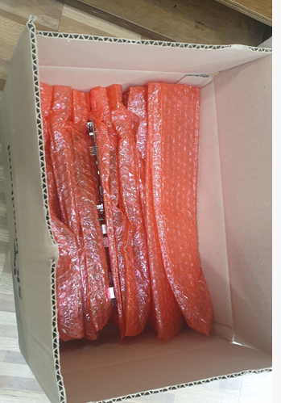
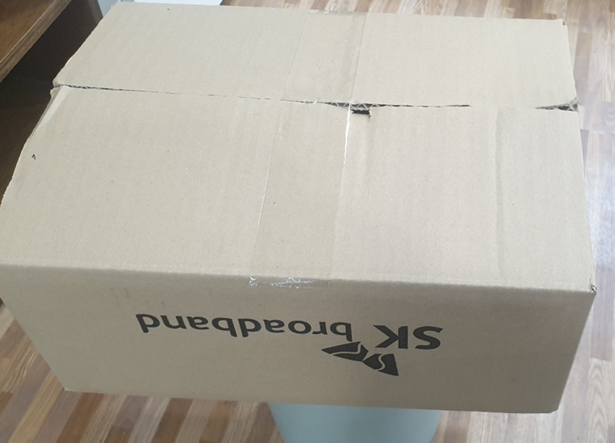
Packing information
PCBA 16pcs
Total weight : 2kg
Carton size : 35*26*15 [cm]

Slide 4

Thank you.

